Slide 1


Bakery Ecommerce
The solution for modern ecommerce
Presented by: YYY (Yuhe Yuan, Fei Yun)

Slide 2

01
Introduction

Slide 3


Problem
Having products sold on platforms (e.g. Amazon) may limit seller's ability to build customer relationship, branding, personalize. A bakery is often sold only to local communities and lack of online presence and data analytics capabilities.
Notes:
Who here has done online shopping before? Do you know the otherside of the story as the seller? For example, if you wish to sell on amazon, you need to pay for the warehouse, shipping to warehouse, deposit and all other fees, and you have to comply with their restrictions on product selection. Most of all, you can’t even sell baked goods on it. Even if you can, there are alot of limitations for bakeries to do branding, building relationships, and personalize their sale items. A bakery is also often only sold to local communities, and lack of online presence and data analytics capabilities.

Slide 4
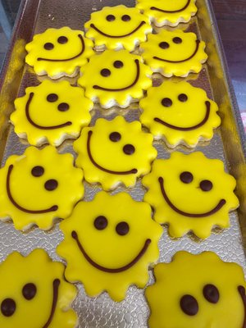
Meaning
Building Brand
Encourage loyalty and brand recognition
Big platform takes credit
Personalization
E.g. add a blog, B2B sale, charity purchase, lessons, etc.
Product flexibility
Marketing
Run creative marketing campaigns
Email list and customer base
Data Analytics
Reports
Notes:
Our solution will bring meaning to bakeries in four ways, allow them to
build their own brand by letting customers always purchasing on their site, big platforms like amazon, you probably do not even remember the brand, but remember that you got it from amazon.
personalized functionalities such as adding B2B sale possible, charity purchase, scheduling lessons and sell whatever you want
give bakery the ability to do special marketing campaigns and collecting customer information
and give some insights on the data that was collected

Slide 5



Solution
The purpose of this project is to provide an e-commerce site for a bakery where customers may browse, order products and bakery manager is able to create, read, update, delete products and order details.
Beyond that, we will include customized functionalities including data analytics, charity purchase, baking lessons scheduling, and etc. It will empower individual bakeries to have better control over their branding and products.
Notes:
we will have basic functionalities as any shopping website,
1. customer can browse and place orders
2. managers can manage orders, changing status, adding new products
3. beyond that we will have customized functions such as charity purchase, baking lesson scheduling and data analytics

Slide 6

02
Evidence

Slide 7


Customer
We supply people who are in need and service food with people who donated
Bakery Classroom gives customers tips and lessons to help them start their bakery journey.

Slide 8
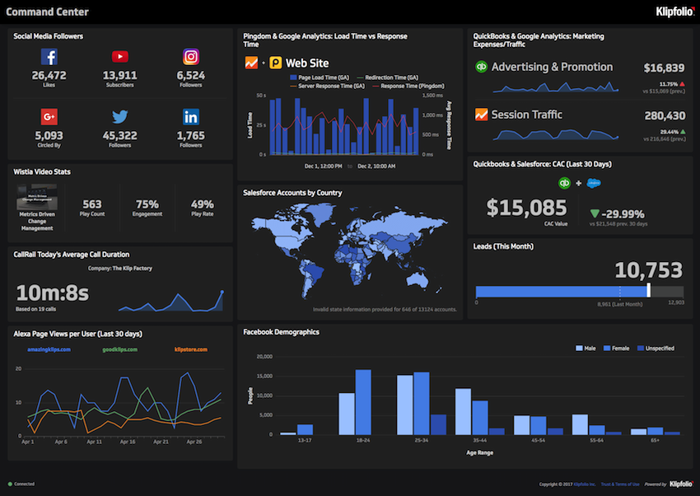
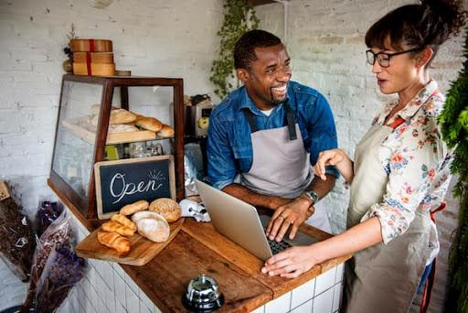
Manager
Comprehensive dashboard supplies detailed order information and dynamic planner let you can track your everyday tasks.
User friendly UI controller let you start and manage your small business faster and anywhere.

Slide 9

03
Prototypes
Notes:
Customer:
index-add item -> cart -> checkout ->Success check out -> Sale -> Our Story -> Contact Us
index: here is the home page for the website where we have a promotional panel displaying current sales or events, and products listed below with the image, option to show detail and add to cart
The header has bakery name, logo as well as cart.
The fotter has basic information such as privacy, contact, and other policies
index-click on item cart to add an item:
Cart page:
we can remove the item, we see the price and description, customer may wish to change the quantity as well. There is also option for gift, charity purchase and for customer to leave comment for each item.
the page also shows some other products that people like and when we check out
Checkout page:
checkout page will require the customer to enter payment and shipping information. Then click on Check out
Sucess check out page:
if the order is sucessfully placed, order number will be displayed to customer as well as the link for them to share.
sales page:
sales page to show all the items on sale
Our story:
for promoting our own brand by showing history, stories and our visions.
Contact:
Contact page also has key informaiton on bakers, policies on privacy, donation or other events.

Slide 10

04
Conclusion

Slide 11

Project
Key to Success:
Frequent communication
Agile Product Requirement Document
Using Project and Monday.com to track progress
Test Driven development

Slide 12



To Conclude...
This project can also...
Transformation into other online ecommerce (e.g. selling games, photos, etc)
Client would love…
Personalized functionalities
Easy navigation
Automatic report system
Next time we will…
Think about mobile users
Cloud service
Automation
System roles
Notes:
This project can be easily translated into selling other stuffs like a game that you build, a service that you may provide
Clients would love to have personalized functionalities and easy controls, reports, maintainability
Next time we will think about mobile users, cloud service possibilities and storage cost, automating some of the stuffs such as sending out reports by email on daily basis

Slide 13

05
Q&A

Slide 14
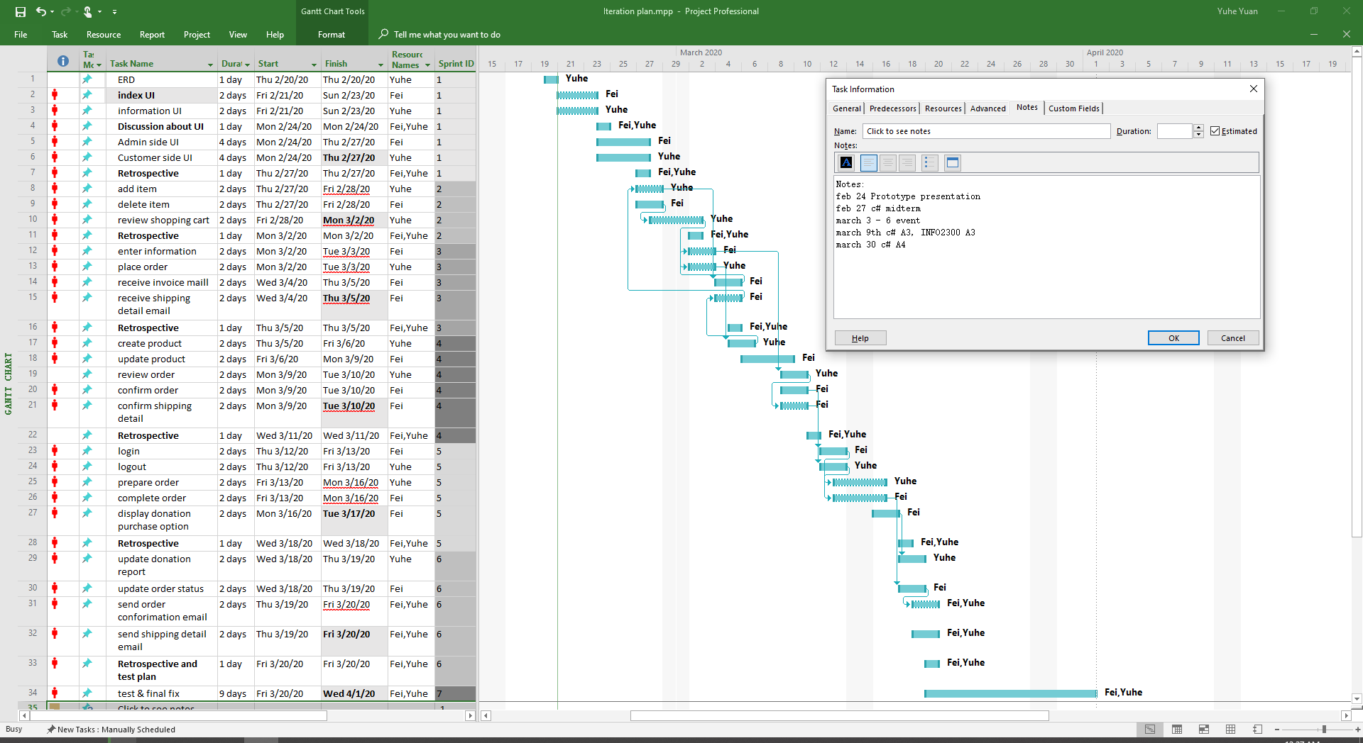
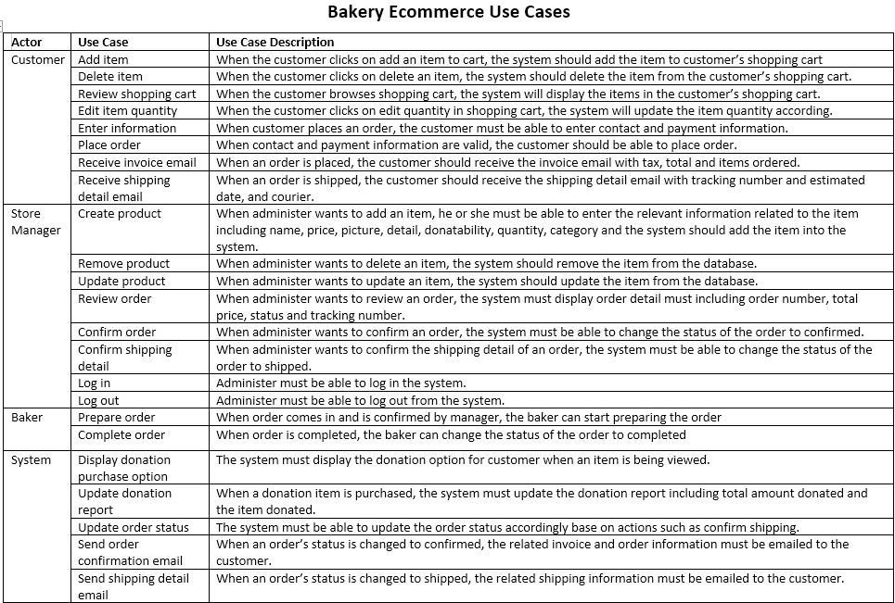
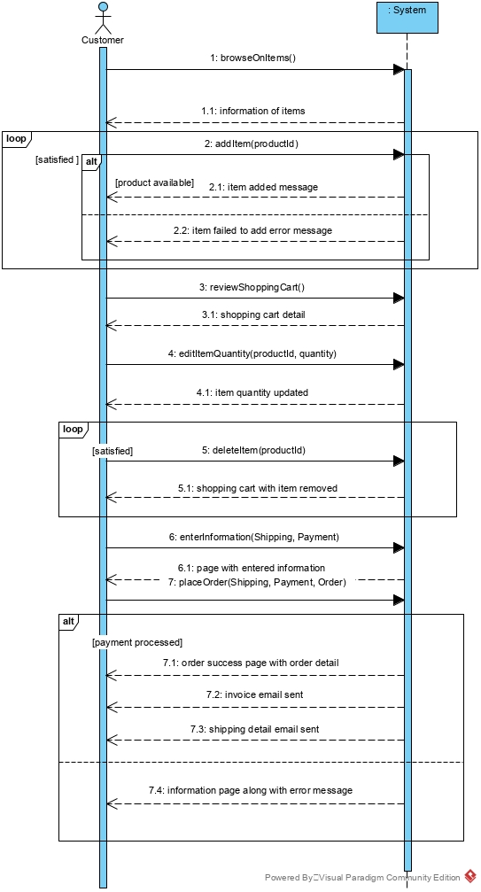

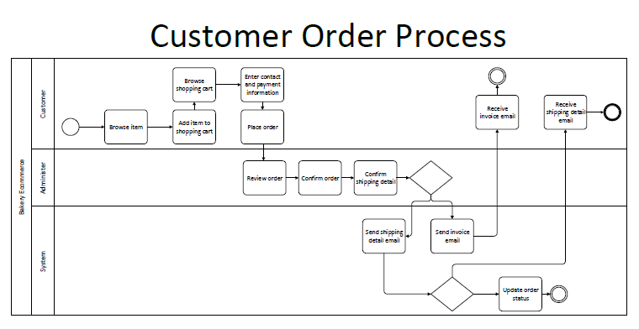
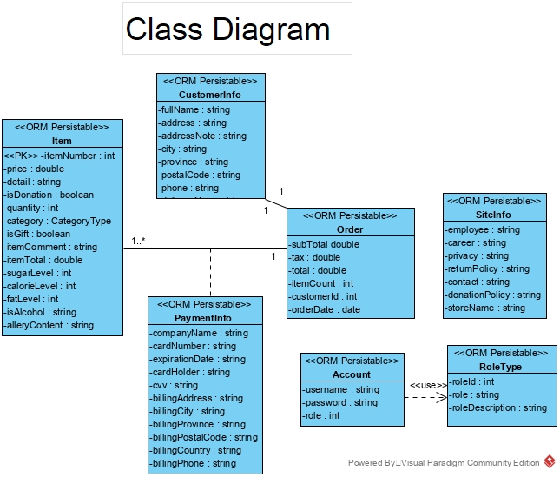
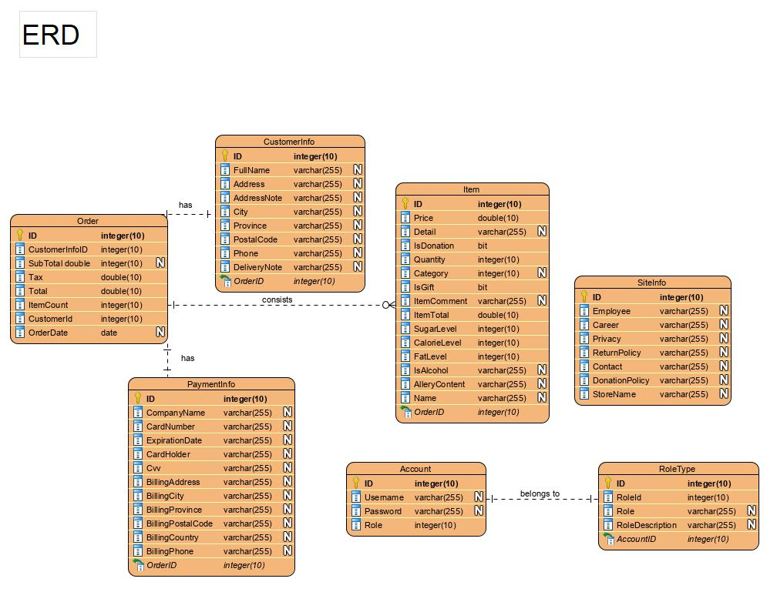
Thank you!
Q&A Time

Slide 15
REFERENCES:
PROTOTYPE CUSTOMER UI

Slide 16
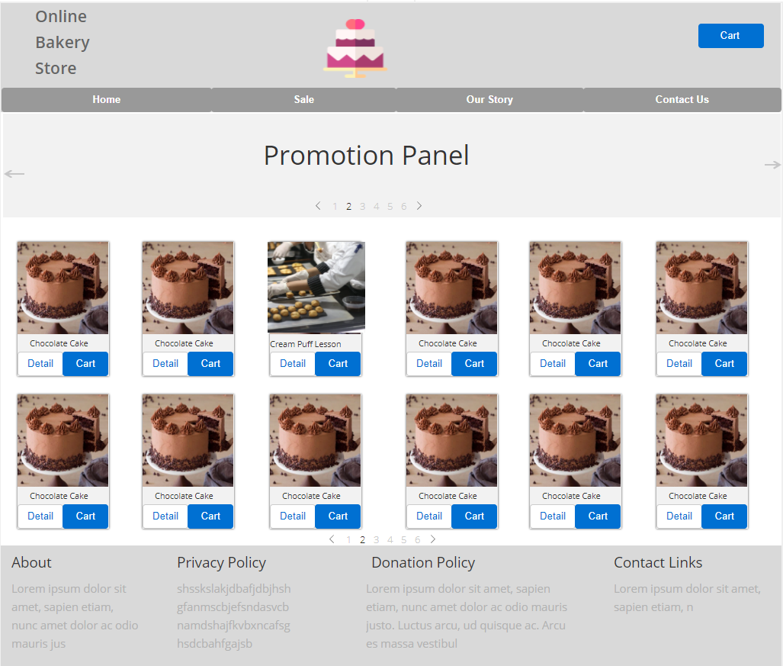
Index

Slide 17
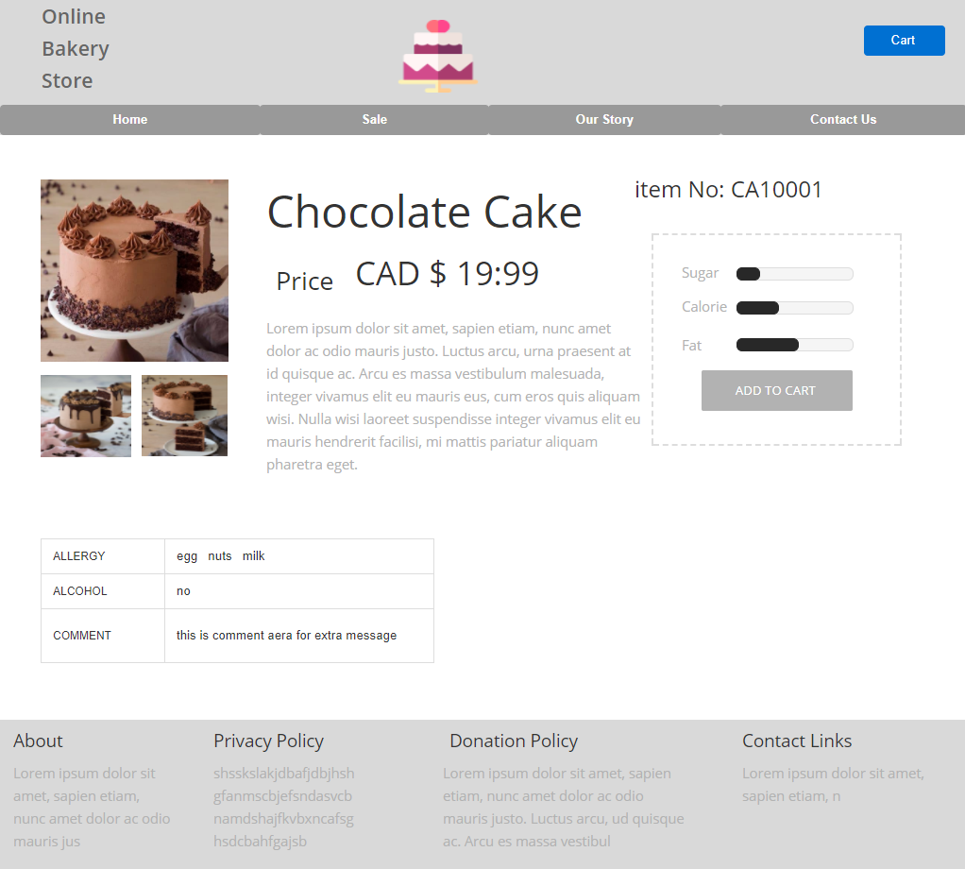
Product Detail

Slide 18
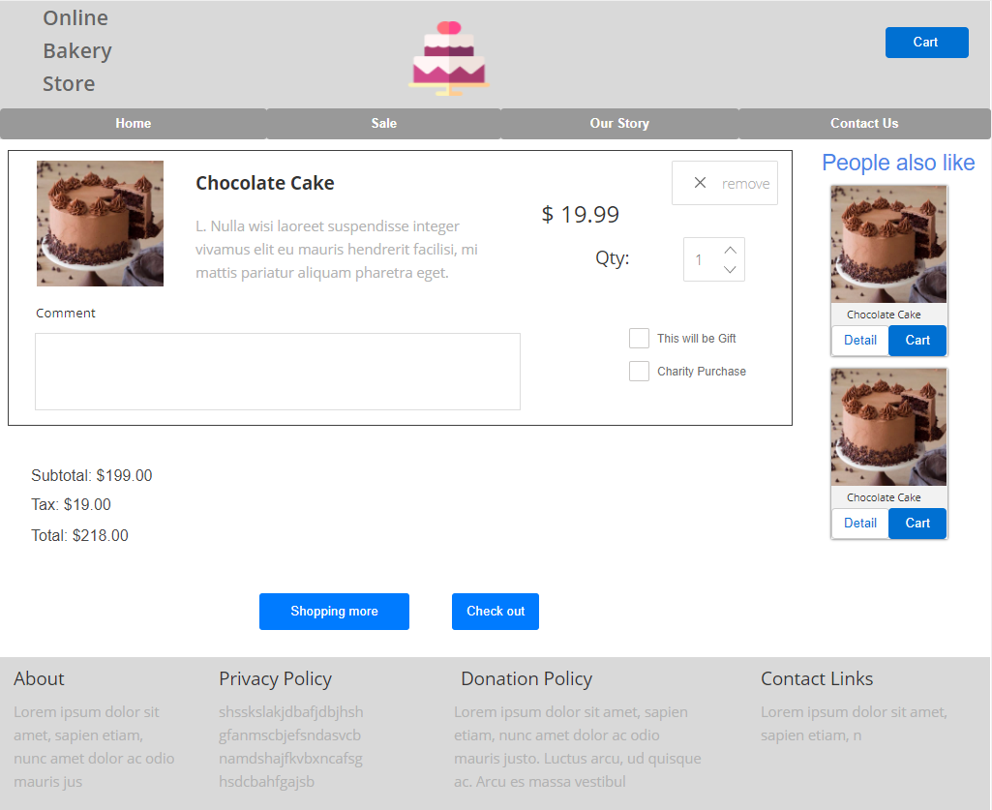
Shopping cart

Slide 19
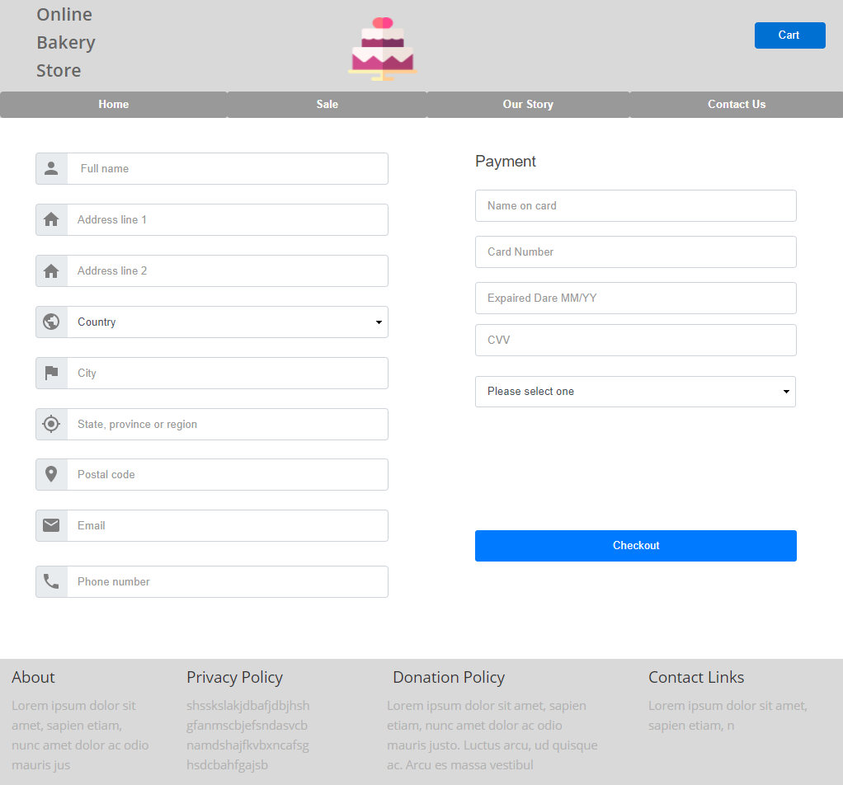
Payment and shipping information

Slide 20
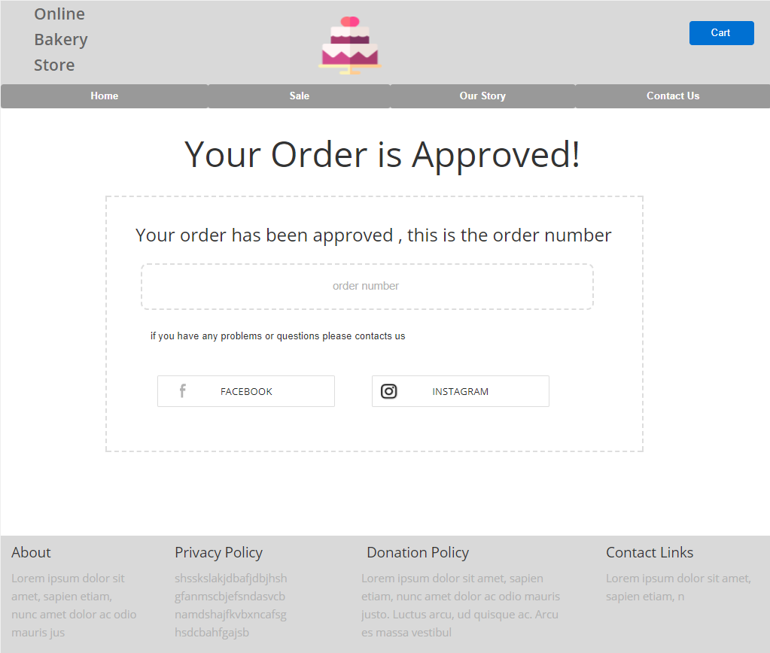
Order approval page

Slide 21
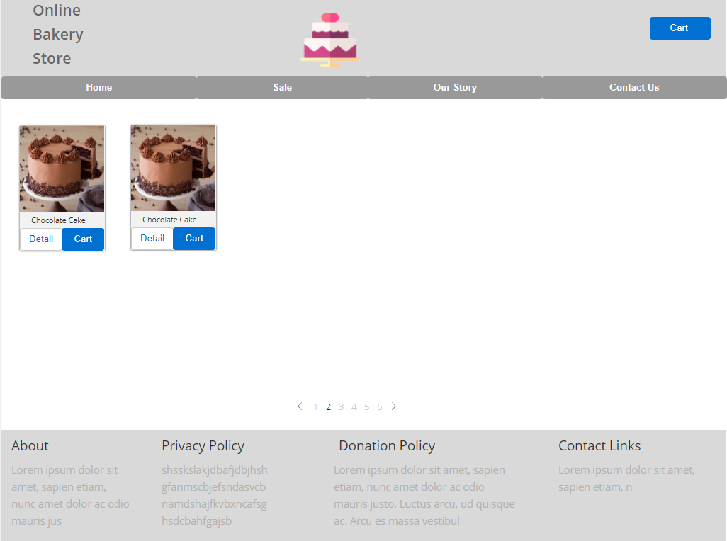
Sales page

Slide 22
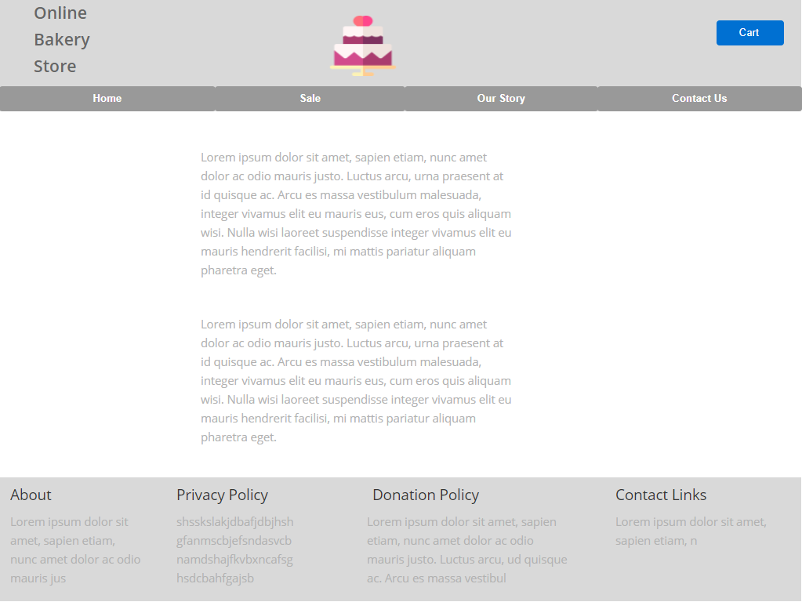
Our story page

Slide 23
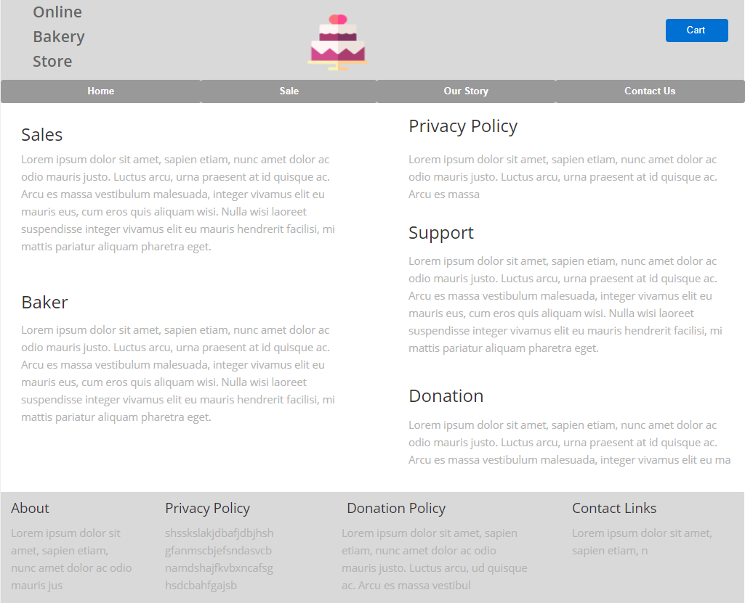
Contact us page

Slide 24
REFERENCES:
PROTOTYPE
Store Manager UI

Slide 25
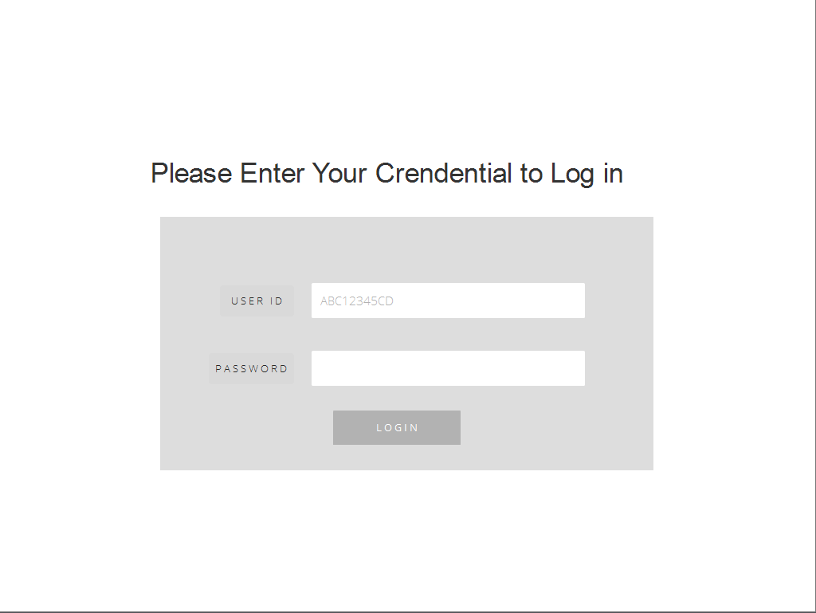
Log in and log out page

Slide 26
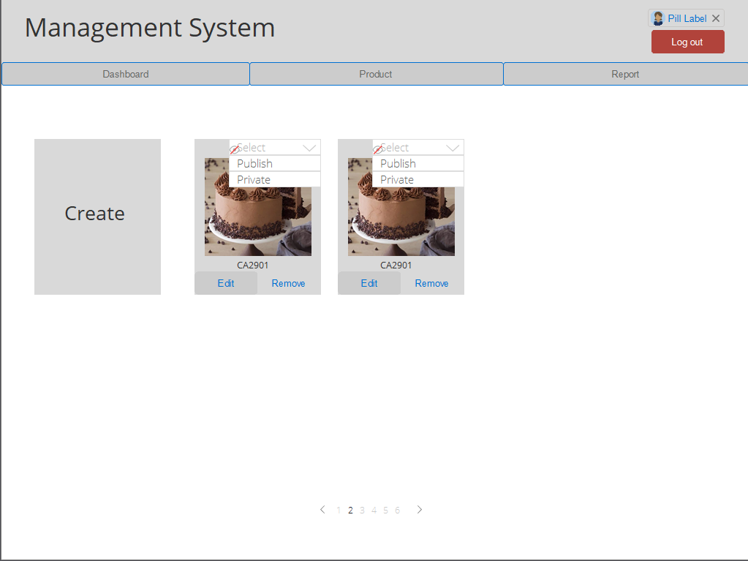
Product page

Slide 27
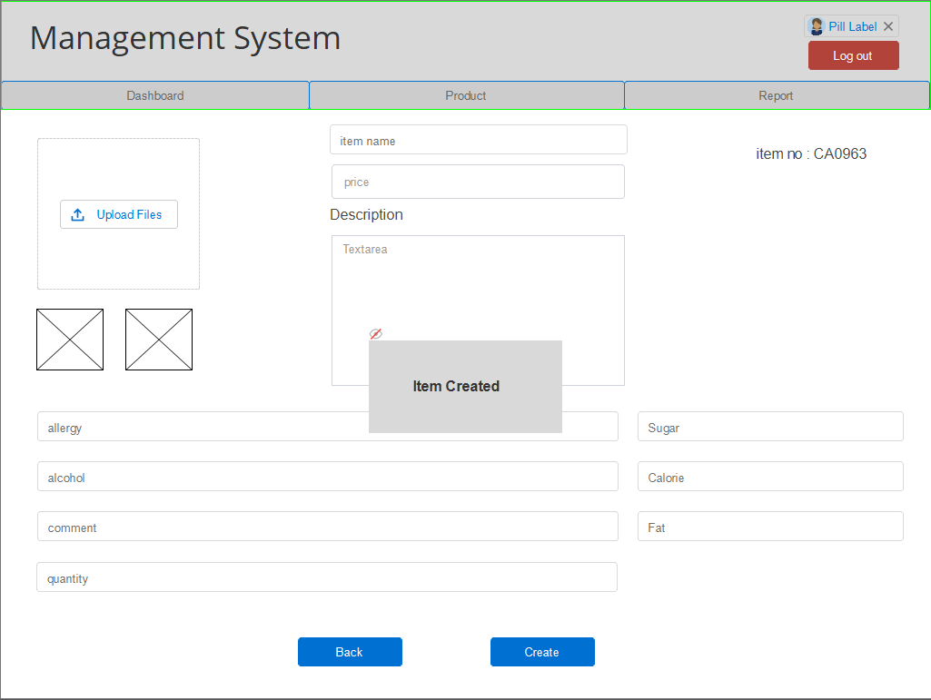
Product create page

Slide 28
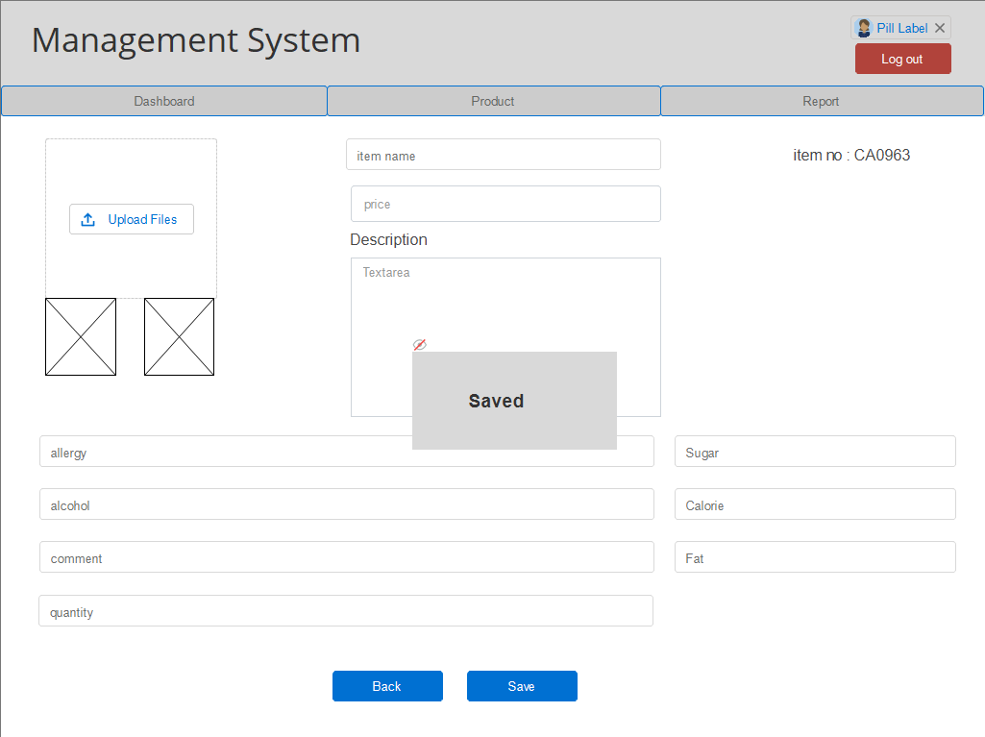
Product edit page

Slide 29
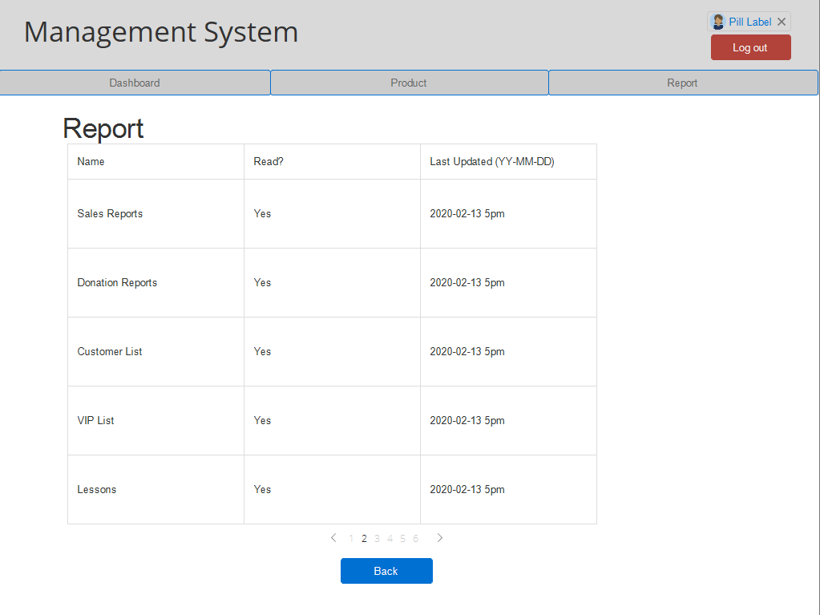
Report page

Slide 30
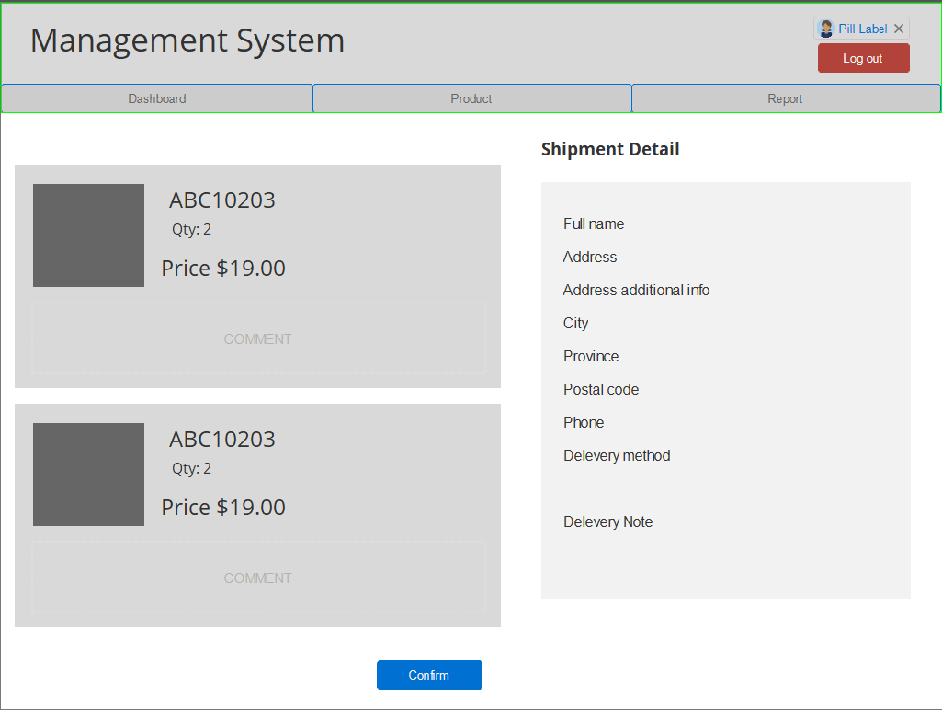
Order detail page

